Slide 1
Enterprise Resource Planning
By Hiren Mistry

Slide 2
Enterprise Resource Planning
ERP is a process of managing all resources and their use in the entire enterprise in a coordinated manner
ERP is a set of integrated business applications, or modules which carry out common business functions such as general ledger, accounting, or order management

Slide 3
What is ERP?
Enterprise Resource Planning
Support business through optimizing, maintaining, and tracking business functions
Broken down into business processes
  HRM
  Distribution
  Financials
  Manufacturing

Slide 4
What makes ERP different
Integrated modules
Common definitions
Common database
Update one module, automatically updates others
ERP systems reflect a specific way of doing business
Must look at your value chains, rather than functions

Slide 5
Benefits of ERP
Common set of data
Help in integrating applications for decision making and planning
Allow departments to talk to each other
Easy to integrate by using processed built into ERP software
A way to force BPR (reengineering)
Easy way to solve Y2K problem

Slide 6
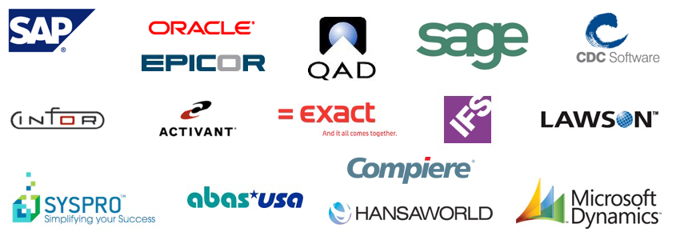
Vendors

Slide 7
Difficulty in implementation
Very difficult
Extremely costly and time intensive
Typical: over $10,000,000 and over a year to implement
Company may implement only certain modules of entire ERP system
You will need an outside consultant

Slide 8
Difficulty in implementation
Very difficult
Extremely costly and time intensive
Typical: over $10,000,000 and over a year to implement
Company may implement only certain modules of entire ERP system
You will need an outside consultant

